Slide 1
Trees

Slide 2
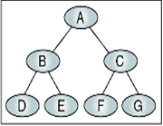
Tree Overview
A tree is mainly used to represent data containing a hierarchical relationship between elements e.g records, Family trees.
Binary Trees:
A Binary Tree T is defined as a finite set of elements called nodes such that:
1) T is empty(Called Null tree or empty tree), OR
2) T contains a distinguished node R, Called the root of T, and the remaining nodes of T form an ordered pair of disjoint binary trees T1 and T2.
If T does Contains a root R, then the two trees T1 and T2 are called respectively the left and right sub trees of R.

Slide 3
Any node N in a binary tree has either 0,1 or 2 successors.
The nodes with no successors are called terminal nodes.
Binary trees T and T’ are said to be similar if they have the same structure or in other words they have the same shape.
The trees are said to be copies if they are similar and if they have the same contents at the corresponding nodes.
Terminology
Suppose N is a node in T with left successor S1 and right successor S2. Then N is called the parent (or father) of S1 and S2.
S1 is called left child of N, and S2 is called right child of N.
S1 and S2 are said to be siblings( or brothers).
Every node N in binary tree, except root has unique parent, called predecessor of N

Slide 4
The line drawn from a node N of T to a successor is called an edge
The sequence of consecutive edges is called a path.
A terminal node is called a Leaf.
A path ending in leaf is called a Branch.
Every node in binary tree T is assigned a level number. The root R of the tree T is assigned the level number 0 and every other node is assigned a level number which is 1 more than the level number of its parent. Further the nodes with same level number are said to belong to the same generation.

Slide 5
The depth of a node is the number of edges from the node to the tree's root node. A root node will have a depth of 0.
The height of a node is the number of edges on the longest path from the node to a leaf. A leaf node will have a height of 0

Slide 6
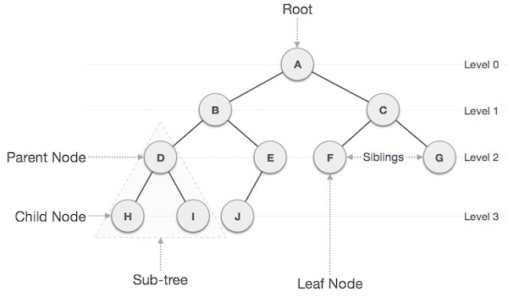

Slide 7
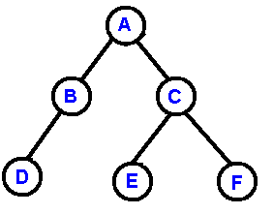
Binary Tree
A binary tree is made of nodes, where each node contains a "left" reference, a "right" reference, and a data element.
The topmost node in the tree is called the root.
Every node (excluding a root) in a tree is connected by a directed edge from exactly one other node. This node is called a parent.
On the other hand, each node can be connected atmost two children nodes.
Nodes with no children are called leaves, or external nodes.
Nodes which are not leaves are called internal nodes. Nodes with the same parent are called siblings.

Slide 8
Complete Binary Tree:
1) Each Node of T can have at most 2 children. Accordingly one can show that level r of T can have at most 2^{r} nodes.
The tree is said to be complete if all its levels except possibly the last have the maximum number of possible nodes, and if all the nodes at the last level appear as far left as possible.
One can easily determine the children of node K are (2*K, 2*K+1), respectively, And parent of any node K is K/2.

Slide 9
Extended Binary Trees: 2-Trees
A binary tree T is said to be a 2-tree or an extended binary tree if each node N has either 0 or 2 Children.
In such case the nodes with 2 children are called internal nodes and nodes with 0 children are called external nodes.
Representation of Trees (BST Insertion)
A binary tree data structure is represented using two methods. Those methods are as follows...
Array Representation
Linked List Representation

Slide 10
Sequential Representation of a tree.
1) The root Node R of T is stored at Tree[1].
2) If a node occupies Tree[K], then its left child is stored in Tree[2*K] and its right
Child is stored in Tree[2*K+1]

Slide 11
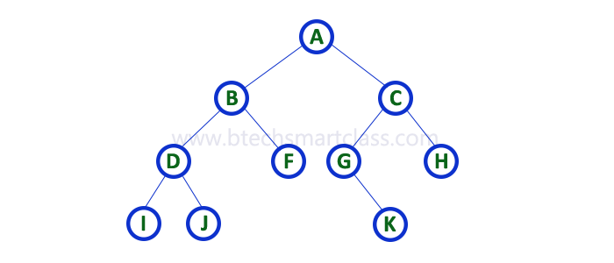

Array Representation
In array representation of binary tree, we use a one dimensional array (1-D Array) to represent a binary tree.
Consider the above example of binary tree and it is represented as follows...

Slide 12

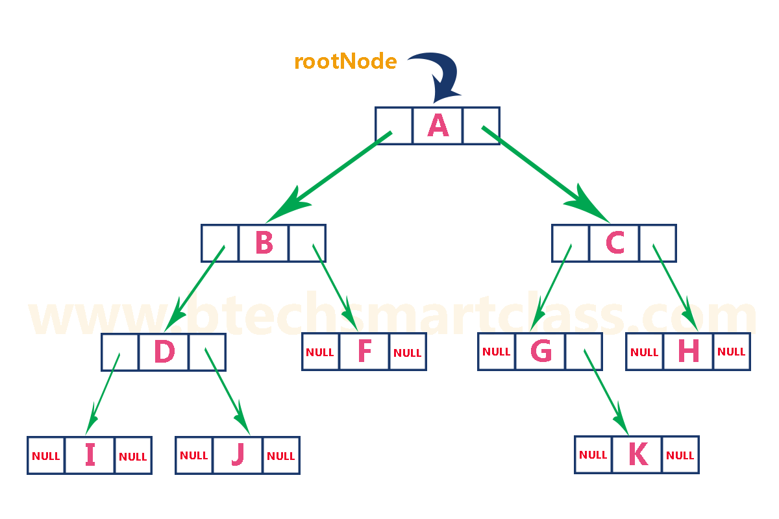
Linked Representation
We use double linked list to represent a binary tree. In a double linked list, every node consists of three fields. First field for storing left child address, second for storing actual data and third for storing right child address.
In this linked list representation, a node has the following structure...
The previous example of binary tree represented using Linked list representation is shown as follows...

Slide 13
Operation on Trees:
Traversing.
Insertion.
Searching.
Deletion

Slide 14
Traversing Binary Trees:
Preorder Algorithm:
a) Process the root R.
b) Traverse the left sub tree of R in Preorder.
c) Traverse the Right sub tree of R in Pre order.
preorder (root)
Step 1: Start
Step 2: Display Root
Step 3: Function Call preorder(root->left)
Step 4: Function Call preorder(root->right)
Step 5: Stop

Slide 15
In-order :
a) Traverse the left sub tree of R in In order.
b) Traverse the Root R.
c) Traverse the Right Sub tree in in order.
inorder (root) Algorithm
Step 1: Start
Step 2: Function Call inorder(root->left)
Step 3: Display Root
Step 4: Function Call inorder(root->right)
Step 5: Stop

Slide 16
3) Post Order :
a) Traverse the left sub tree of R in Post order.
b) Traverse the Right Sub tree in Post order.
c) Traverse the Root R.
postorder (root) Algorithm
Step 1: Start
Step 2: Function Call postorder(root->left)
Step 3: Function Call postorder(root->right)
Step 4: Display Root
Step 5: Stop

Slide 17
A,B,D,G,H,K,C,E,F
Example :
→ PreOrder
A
G
F
B
D
E
C
H
K

Slide 18
K,G,D,L,H,M,B,A,E,C
A
G
B
D
E
C
→ In Order
H
K
L
M

Slide 19
K,G,L,M,H,D,B,E,C,A
A
G
B
D
E
C
A
G
B
D
E
C
→ Post Order
H
K
L
M

Slide 20
Binary Search tree
Suppose T is a binary tree. Then T is called a binary search Tree if each Node N of T has the following property.
The value of N is greater than every value in the left subtree of N and is less than every value in the right subtree of N.
A binary search tree is a binary tree such that for every node in the tree, all of the entries in the left sub-tree (if any) are smaller than the entry in the node and all of the entries in the right sub-tree (if any) are larger than the entry in the node.
6
6
3
7
5
7
2
5
9
2
3
9
a binary search tree
not a binary search tree
Note: there is no requirement that a binary search tree be a complete binary tree.

Slide 21
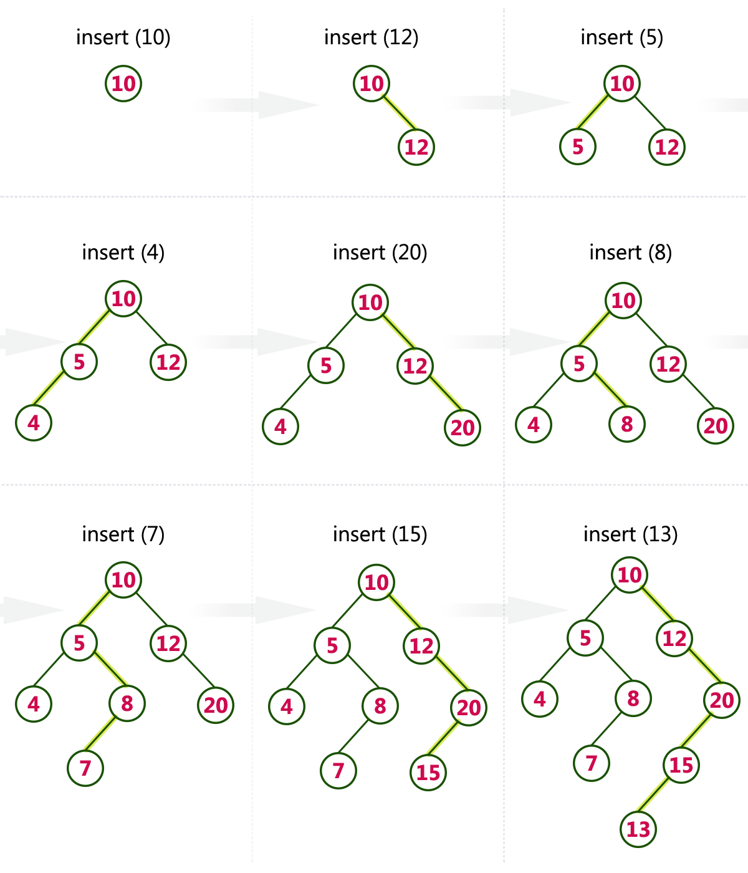
Make a BST of list 10,12,5,4,20,8,7,15 and 13

Slide 22
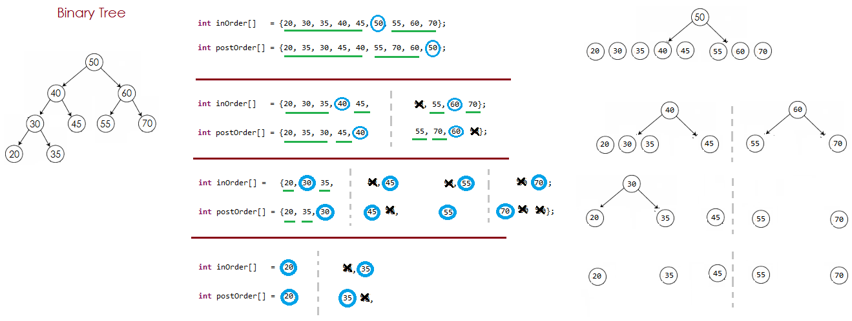
Draw a Binary search tree from given traversal orders Case 1 : Inorder and PostOrder

Slide 23
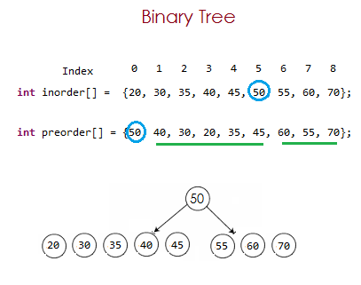
Draw a Binary search tree from given traversal orders Case 2 : Inorder and PreOrder

Slide 24
Steps :
Step 1: Read the first element from Pre order traversal which is root node. Now, we come to know which is root node.(in our case it is 50)
Step 2: Search the same element (element 50) in In-order traversal, when the element is found in In-order traversal, then we can very well say that all the elements present before the node found are Left children/sub-tree and all the elements present after the node found are Right children/sub-tree of node found. (as in In-order traversal Left child's are read first and then root node and then right nodes.)
In our example, In-order traversal : 20 30 35 40 45 50 55 60 70
Pre-order traversal : 50 40 30 20 35 45 60 55 70
(20, 30, 35, 40, 45) will be part of Left Sub-tree of Node 50.
(55, 60, 70) will be part of Right Sub-tree of Node 50.
Now we got the fresh inOrder (20, 30, 35, 40, 45) and (55, 60, 70)
Repeat the Step 1 and Step 2 for new inOrder
Note: We will find the root node from Pre-order/Postorder traversal and then left child's and right child's from In-order

Slide 25
Make a binary tree out of these traversals :
1) In-Order: E,A,C,K,F,H,D,B,G
Pre-Order: F,A,E,K,C,D,H,G,B
2) In-order (4,7,2,8,5,1,6,9,3)
Pre-Order(1,2,4,7,5,8,3,6,9)

Slide 26
Algorithm: Search in BST
Start from the root node.
If the root is NULL, the item is not found.
If the key equals the root’s value → return found.
If the key is less than the root’s value → search in the left subtree.
If the key is greater than the root’s value → search in the right subtree.
Repeat until the item is found or you reach NULL.

Slide 27
Delete a node from BST
DeleteBST(root, key): if root == NULL: return root if key < root.data: root.left = DeleteBST(root.left, key) else if key > root.data: root.right = DeleteBST(root.right, key) else: // Node found
// Case 1 & 2: one or no child if root.left == NULL: return root.right else if root.right == NULL: return root.left // Case 3: two children temp = MinValueNode(root.right) root.data = temp.data root.right = DeleteBST(root.right, temp.data) return root

Slide 28
Need for AVL Rotations & Balance Factor
AVL trees must remain height-balanced for efficient operations
Prevents degradation to O(n) (like a skewed tree)
Ensures O(log n) time for search, insert, delete
Balance Factor (BF):
Formula: BF = Height(Left Subtree) − Height(Right Subtree)
Values:
-1, 0, +1 → Balanced
<-1 or >+1 → Unbalanced (rotation needed)

Slide 29
Types of AVL Rotations
Four Cases of Imbalance:
Left-Left (LL) → Right Rotation
Right-Right (RR) → Left Rotation
Left-Right (LR) → Left + Right Rotation
Right-Left (RL) → Right + Left Rotation

Slide 30
LL & RR Rotations
LL Rotation (Right Rotation):
Occurs when node inserted in left subtree of left child
Fix: Single Right Rotation
RR Rotation (Left Rotation):
Occurs when node inserted in right subtree of right child
Fix: Single Left Rotation

Slide 31
LR Rotation
Left-Right (LR):
Occurs when node inserted in right subtree of left child
Fix:
Left Rotation on left child
Right Rotation on unbalanced node

Slide 32
RL Rotation
Right-Left (RL):
Occurs when node inserted in left subtree of right child
Fix:
Right Rotation on right child
Left Rotation on unbalanced node

